Slide 1
DB Check Automation

Slide 2
Output Structure
DB Check initial output shows basic database information like ..
DB Name
DB Role
Database Release
Instance Name/Status
Instance Start time
Pluggable Database status

Slide 3
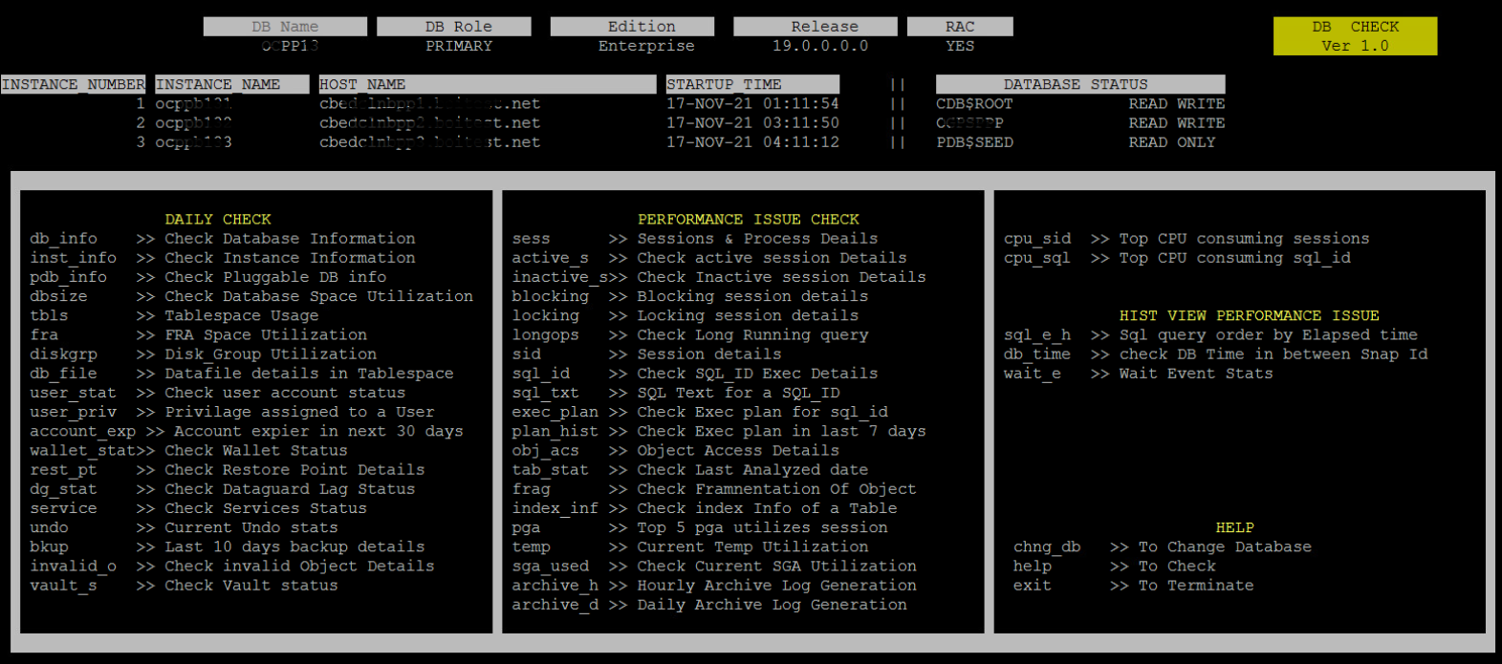
Output Structure
The First two lines show
Database Name
Database Role
Edition
Release
RAC / Non-RAC
In Right corner it will display current version of the tool
Instance number
Instance Name
Host Name
Startup Time
Pluggable database details

Slide 4
Output Structure
Options available in tool
Each option contain two parts
The command to call that option
A short description on option

Slide 5
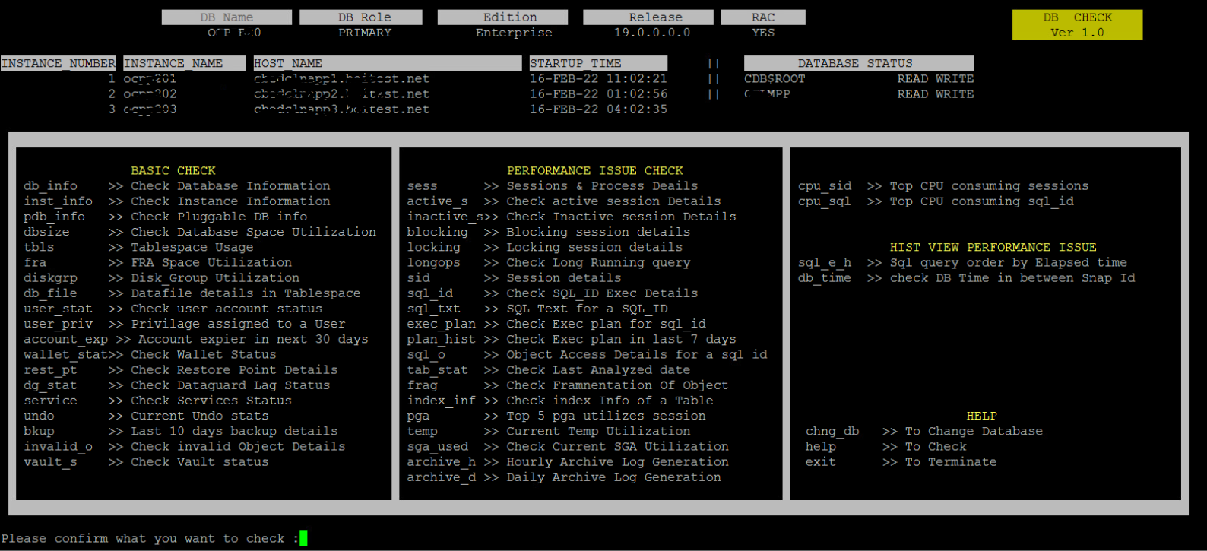
Output Structure
Please confirm what you want to check :
This message will display at the bottom of screen, and we need to pass the options as per our requirement.

Slide 6
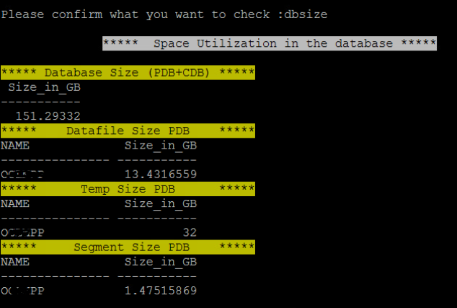
Detailed usage of Options..
dbsize
It will show database size for both pluggable database and container database.
If multiple pluggable database present in the container it will show size for each pluggable DB Separately.

Slide 7
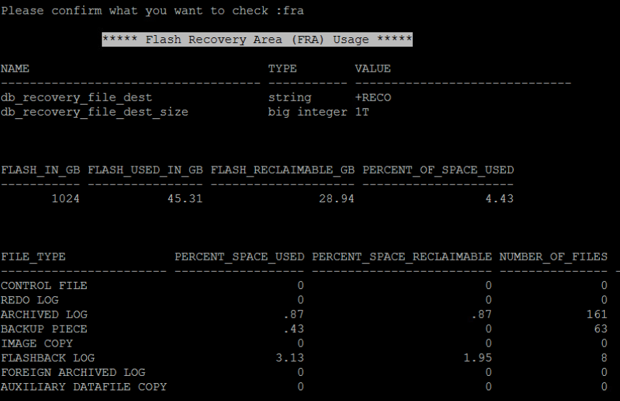
Detailed usage of Options..
fra
fra is used to check fast_recovery_area allocation and utilization.
.

Slide 8
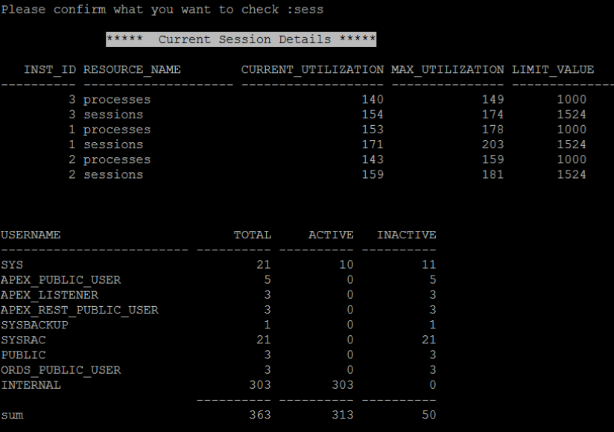
Detailed usage of Options..
sess
sess command used to check current session utilization,max session utilization and limit value
It also show current active and inactive session count details in the database with respect to username

Slide 9
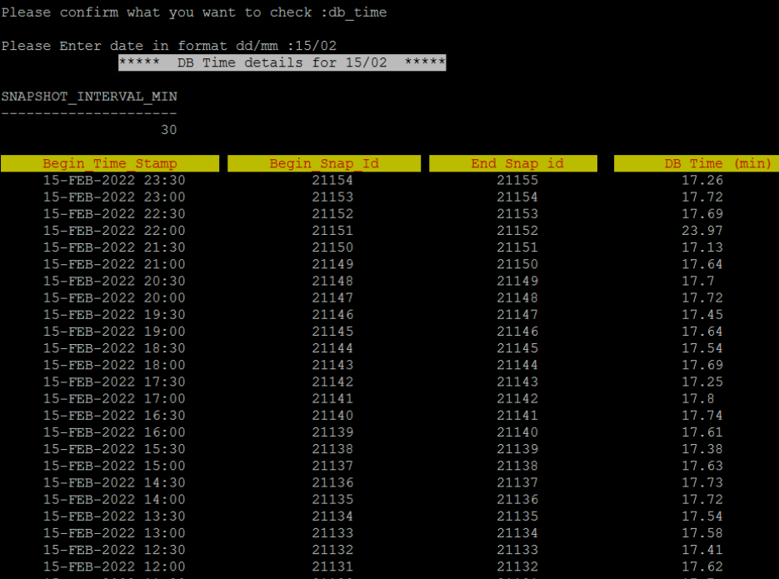
Detailed usage of Options..
dbtime
dbtime is used to check DB Time for a particular day.
We need to pass date value in dd/mm format. The output contain DB Time in for each snapshot interval.
** DB Time is a time model statistic that is the sum of Oracle process CPU consumption and non-idle wait time

Slide 10
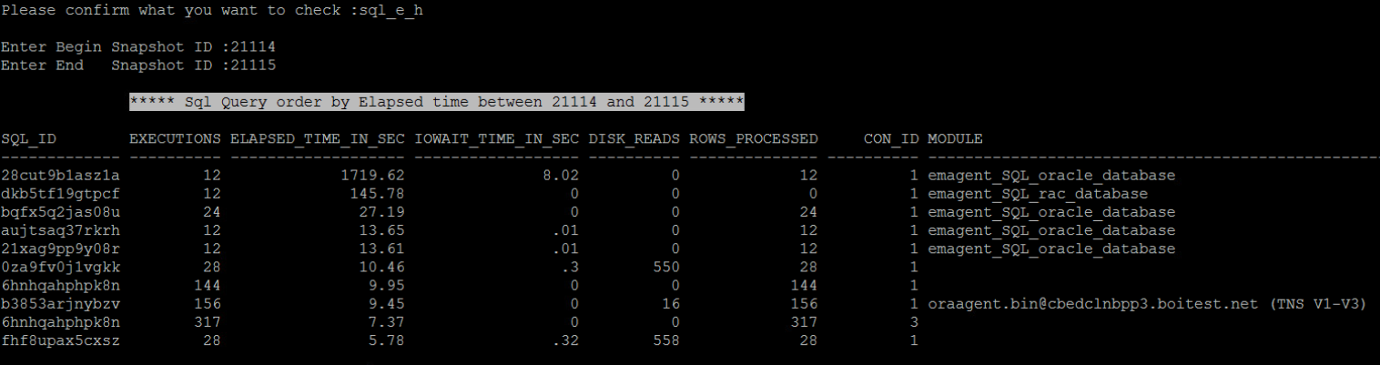
Detailed usage of Options..
sql_e_h
sql_e_h is used to check SQL ids order by elapsed time. Here we need to pass snap_id for the interval. We can get snap_id details from dbtime option

Slide 11
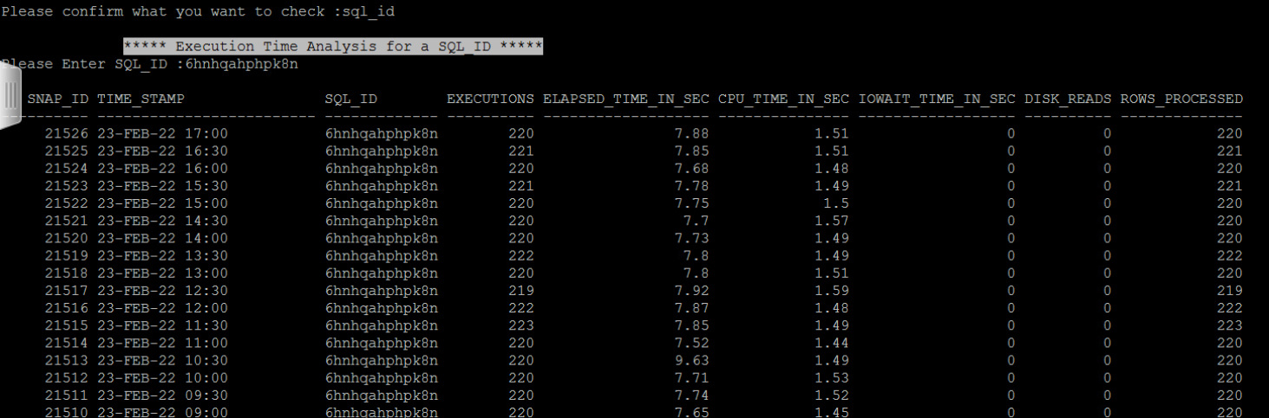
Detailed usage of Options..
sql_id
It used to check Execution details for a particular sql id.

Slide 12
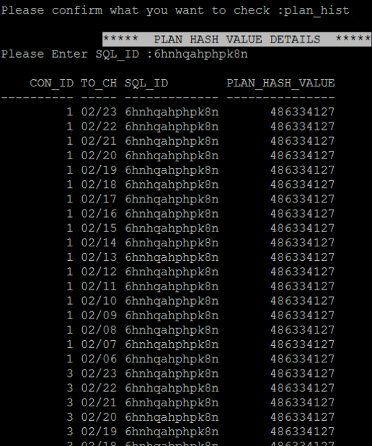
Detailed usage of Options..
plan_hist
plan_hist is used to check plan_hash_value for a particular sql id.
Here we need to pass sql id

Slide 13
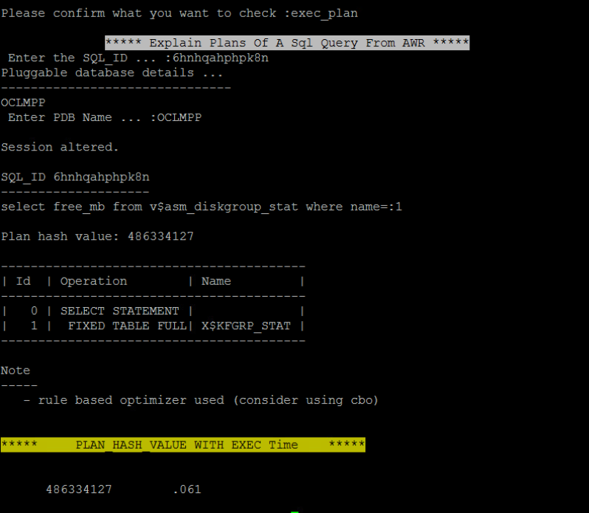
Detailed usage of Options..
exec_plan
exec_plan is used to check execution plan details for a sql id.
It will show average execution time wrt each plan_hash_value

Slide 14
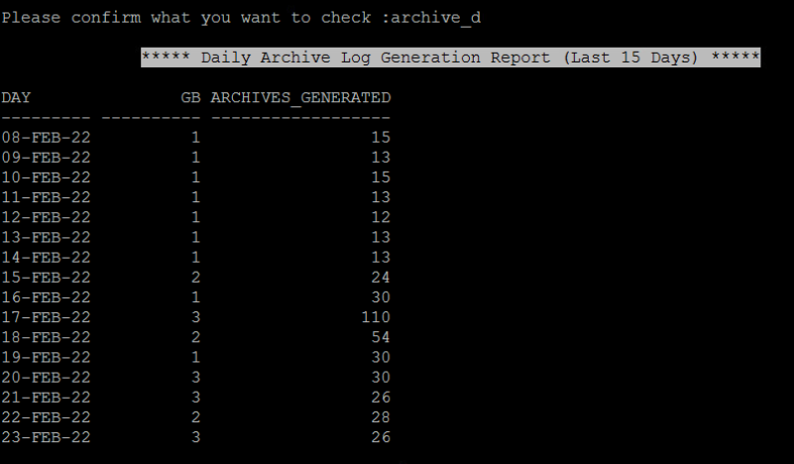
Detailed usage of Options..
archive_d
archive_d is used to check daily archive generation rate
archive_h
archive_h is used to check hourly archive generation rate

Slide 15
End of Presentation
Thank You

